Slide 1


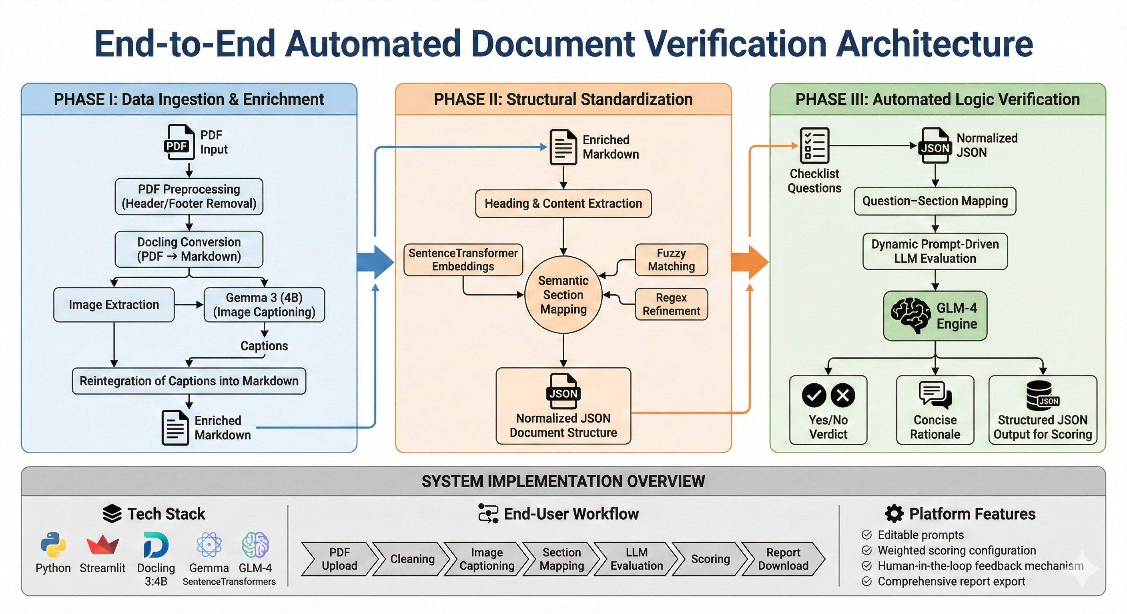
LLM Based Web Application For SQAG Document’s Verification
Aayush Anand M.B Sai Charan (Sci-C), A.Kalidasu (Sci-E)
Overview
Software Quality Assurance Group (SQAG) under DRDO reviews a large number of technical documents such as SRS, SDD, ICD, and test plans. Many incoming documents suffer from incorrect templates, missing sections, irrelevant content, and unclear diagrams, making manual review slow and inconsistent.
This project proposes an AI-assisted initial screening and verification system to reduce reviewer burden and improve standardization.
Problem Statement
Manual SRS verification is time-consuming and repetitive
Inconsistent document formats and terminology
Missing or poorly structured sections
Embedded images and diagrams are not machine-readable
Objective
Develop an LLM-based web application for SRS verification
Build a modular AI pipeline with independent components
Automate PDF pre-processing and image understanding
Perform semantic section mapping to SQAG templates
Enable prompt-driven compliance checking.
Provide an interactive Streamlit dashboard with scoring, feedback and reports to download.
Motivation
Need for faster and consistent compliance checks
Reduce manual effort and reviewer fatigue
Methodology
Phase I: Data Ingestion & Enrichment
PDF preprocessing (header/footer removal)
PDF → Markdown conversion using Docling
Image extraction and captioning using Gemma 3 (4B)
Reintegration of captions into Markdown
Phase II: Structural Standardization
Heading & content extraction
Semantic section mapping using:
SentenceTransformer embeddings
Fuzzy matching
Regex refinement
Normalized JSON document structure
Phase III: Automated Logic Verification
Checklist question–section mapping
Dynamic prompt-driven LLM evaluation
GLM-4 generates:
Yes/No verdict
Concise rationale
Structured JSON output for scoring
RESULTS & EVALUATION
Tested on 7 SRS documents
100% heading mapping accuracy
100% image caption reintegration
80–90% LLM reasoning consistency
Review time reduced from hours to minutes
High repeatability and stability
Strong alignment with real SQAG workflows
CHALLENGES
Irregular SRS templates
Complex diagrams and multi-part figures
Noisy PDF layouts
Semantic variation in section names
LLM prompt sensitivity
Preventing hallucination and ensuring grounding
CONCLUSION
Successfully developed a LLM-based SRS verification system
Reduced manual review effort significantly
Achieved structured, explainable compliance evaluation
Demonstrated practical use of multimodal LLMs in defense documentation
Validated modular AI pipelines for document intelligence
FUTURE SCOPE
Support for SDD, ICD, STR documents
Automatic template detection
Advanced table understanding
RAG-based verification for complex questions
User authentication & access control
Improved UI/UX and feedback-driven learning
REFERENCES
(Condensed to 4–5 key papers for poster)
Docling v2 (2025)
Gemma 3 Technical Report
Chain-of-Thought Prompting
READoc Benchmark
Check-Eval Framework

